Slide 1
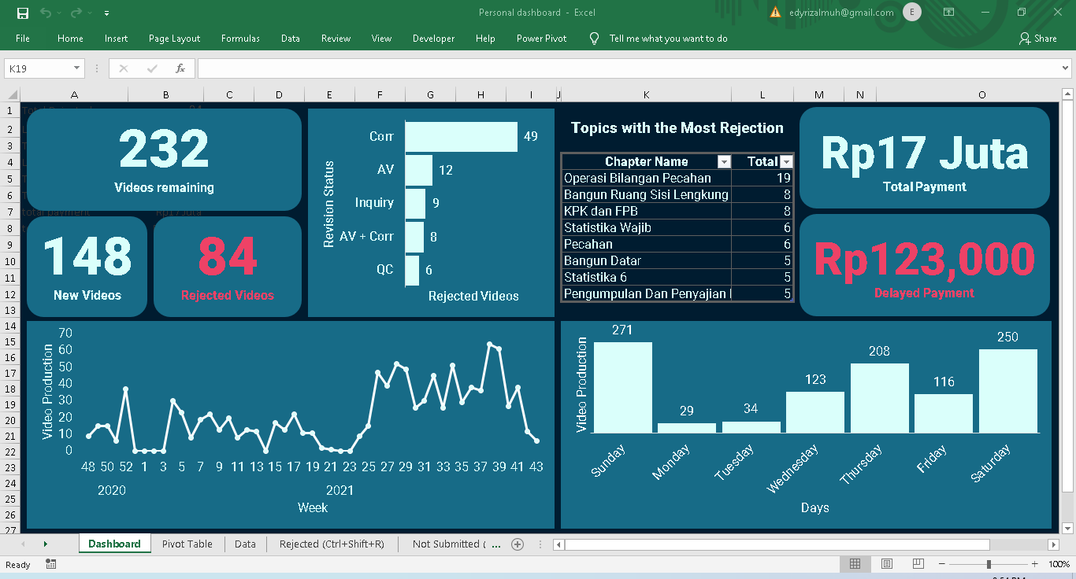

Slide 2
The file has 5 sheets

Slide 3
The 1st sheet: The “Dashboard” sheet has 4 sections

Slide 4
Section 1 shows the tasks remained

Slide 5
Section 2 shows the evaluation of the rejected videos

Slide 6
Section 3 shows the payment status

Slide 7
Section 4 shows the submission evaluation

Slide 8
All sections are automatically updated when the data sheet is updated

Slide 9
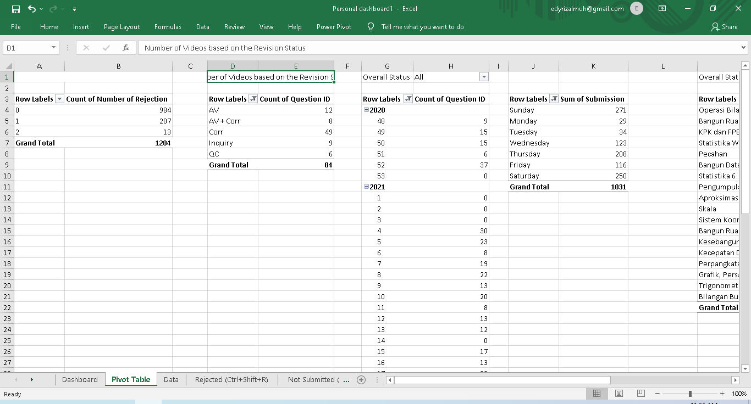
The 2nd sheet: The “Pivot table” sheet, automatically updated using macro

Slide 10
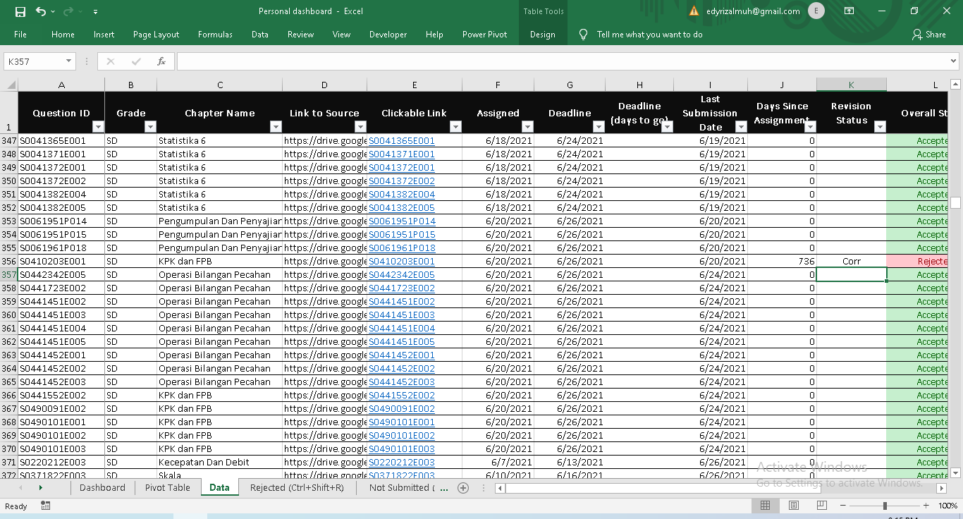
The 3rd sheet: The “Data” sheet, containing all the data

Slide 11
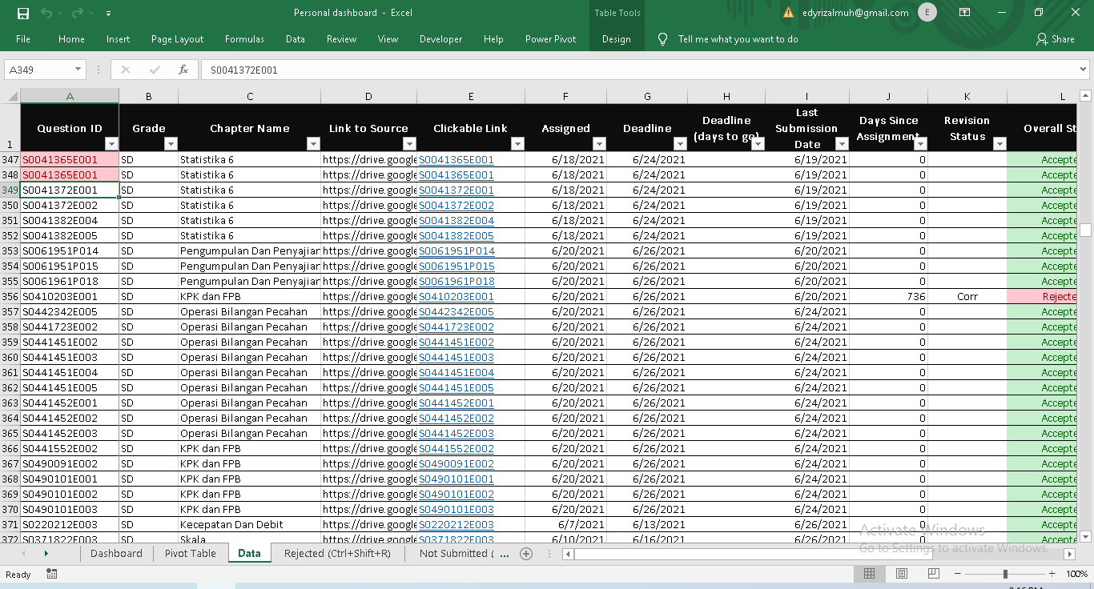
Conditional highlighting to detect duplicated ID

Slide 12
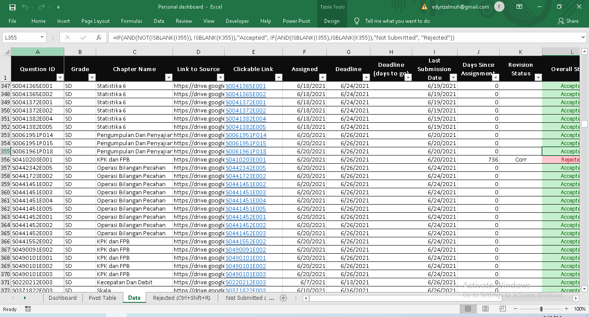
Automatically changing values using formula

Slide 13
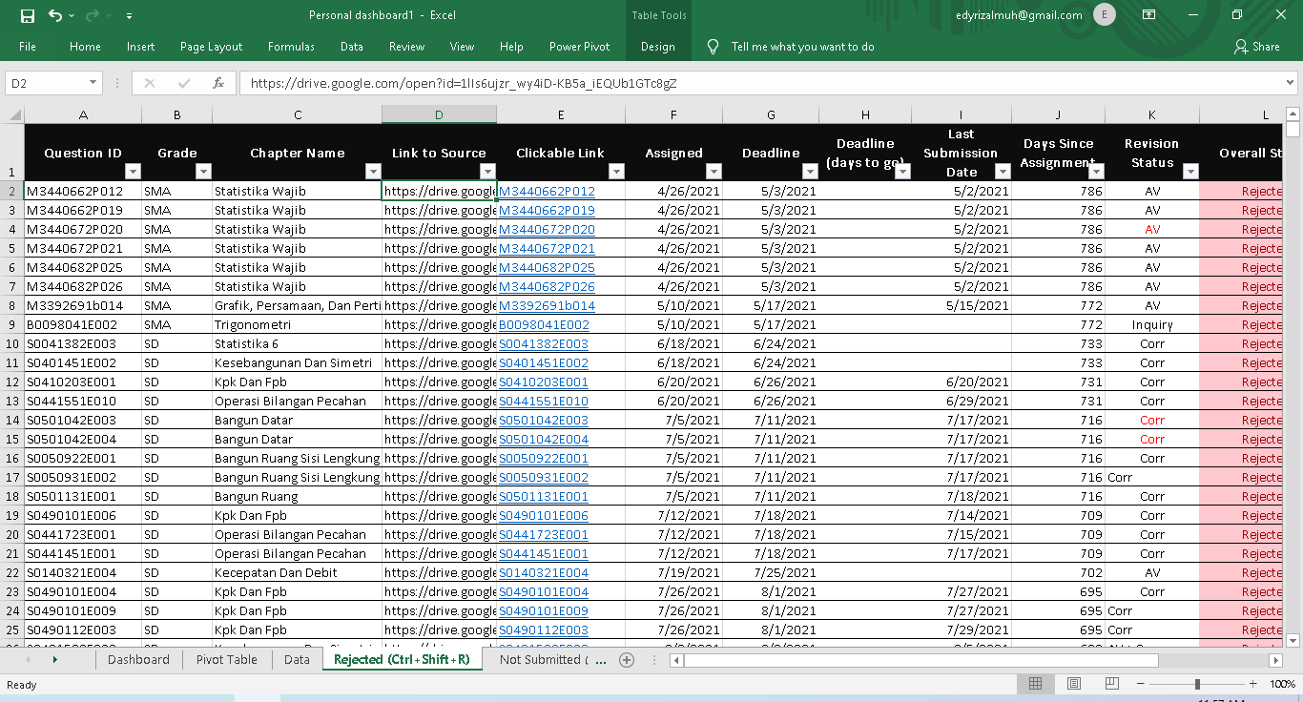
The 4th sheet: The “Rejected” sheet, filtered using macro, Ctrl + Shift + R to refresh

Slide 14
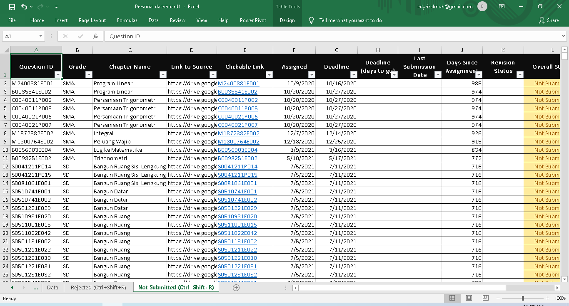
The 5th sheet: The “Not submitted” sheet, filtered using macro, Ctrl + Shift + R to refresh

